Slide 1
Homework
Week 3

Slide 2
Question 1
Tanya recorded temperatures on a mountain over four days. Which list gives four temperatures arranged in order from lowest to highest?
0°C, -3°C, 4°C, -5°C
-3°C, -5°C, 0°C, 4°C
-5°C, 4°C, -3°C, 0°C
-5°C, -3°C, 0°C, 4°C
ANSWER = D

Slide 3
Question 2
25% of Rochelle’s income is spent on rent. If Rochelle earns $1280 per week, how much is her weekly rent?
25% =
1280 ÷ 4 = $320
ANSWER = $320

Slide 4
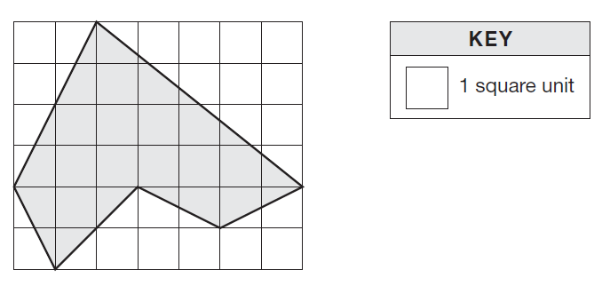
Question 3
What is the area of this shape in square units?
Process 1:
Combine partial squares to make full squares
Count number of full squares.
Process 2:
Break into triangles
Count number of squares in each rectangle that the triangle is in, and then divide by 2.
ANSWER = 19 square units

Slide 5
Question 4
When it is 11 am in Perth, it is 3pm in Auckland on the same day. At 9 pm in Perth, Sophie phoned a friend in Auckland. What was the time in Auckland when Sophie phoned?
3pm – 11 am = 4 hour time difference
Auckland is 4 hours in front of Perth
Time in Auckland = 9 + 4
= 1 am
ANSWER = 1 am

Slide 6
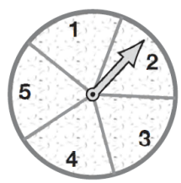
Question 5
This spinner has five equal sections that are numbered 1, 2, 3, 4 and 5. What is the chance, as a fraction, of getting an odd number with one spin?
There are 3 odd numbers
P(odd) = ⅗
ANSWER = ⅗

Slide 7
Question 6
What is the next number in the pattern: 2, 2.6, 3.2, 3.8, 4.4?
2.6 – 2 = 0.6
3.2 – 2.6 = 0.6
You are adding 0.6 to get the next number in the pattern each time.
Next number in the pattern = 4.4 + 0.6
= 5.0
ANSWER = 5.0

Slide 8
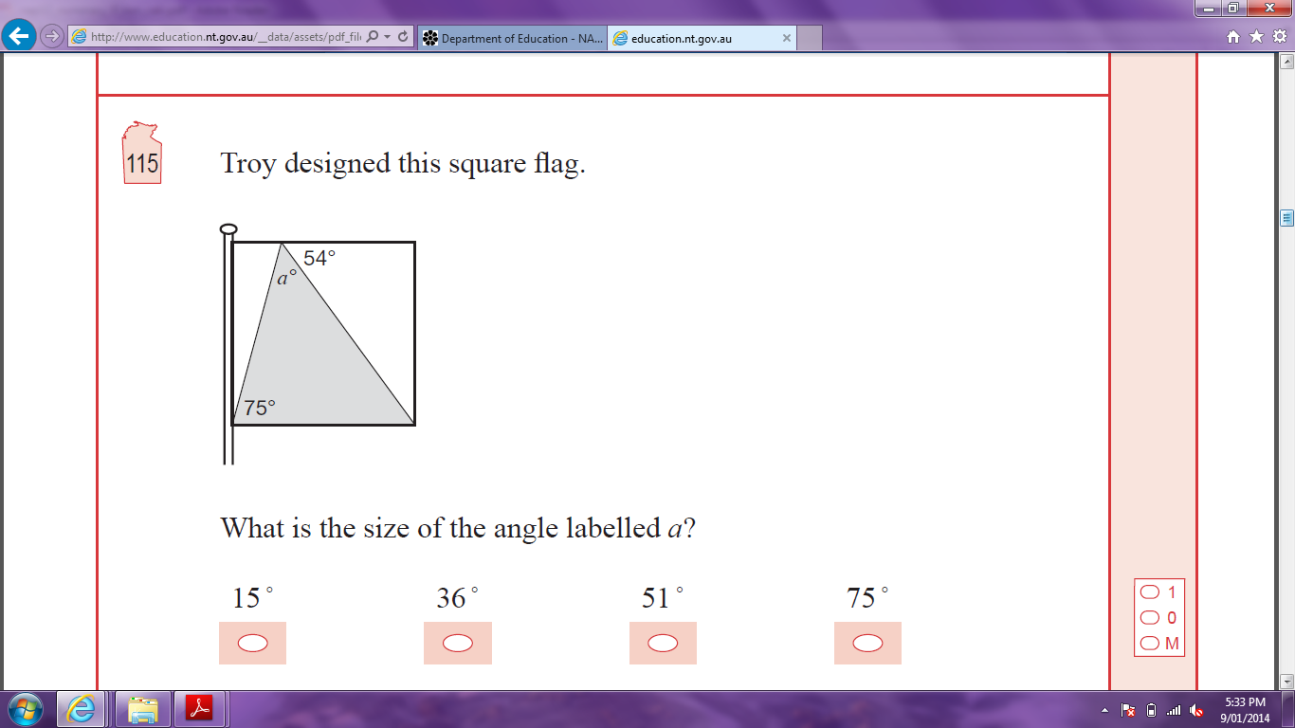
Question 7
Troy designed this square flag. What is the size of the angle labelled a?
180° - 54° - 90° = 36°
90° - 36° = 54°
a = 180 ° - 54° - 75°
= 51°
ANSWER = 51°

Slide 9
Question 8
What fraction has the same value as ?
(3 x 5 = 15)
x
Answer = C

Slide 10
Question 9
Which value of x does not satisfy the inequality 2x – 3 ≤ 8?
When x = -4
2 x -4 -3 ≤ 8
-11 ≤ 8  Satisfies inequality
When x = 0
2 x 0 - 3 ≤ 8
-3 ≤ 8  Satisfies inequality
When x = 5
2 x 5 - 3 ≤ 8
8 ≤ 8  Satisfies inequality When x = 7
When x = 7
2 x 7 - 3 ≤ 8
11 ≤ 8  Does not satisfy inequality
Answer = D

Slide 11

Question 10
The area of this rectangle is 85 cm². What is the length of the rectangle?
Length = 85 ÷ 5
= 17 cm
Answer = 17 cm
85 cm2

Slide 12
Question 11
Here is a set of five scores: 4, 2, 6, 4, 4. Which is equal to 4?
Mode only
Mode and range only
Mode, mean and range only
Mode, mean, median and range
mean =
=
= 4
mode = 4
median = 2, 6, 4, 4, 4 = 4
range = 6 – 2
= 4
Answer = D

Slide 13
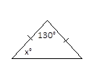
Question 12
What is the value of x?
It is an isosceles triangle.
ANSWER = 25°

Slide 14
Question 13
A section of an 8-strand wire fence is shown. The fence has 3 barbed wire strands and 5 plain wire strands.
Barbed wire costs $b per metre. Plain wire costs $p per metre. Which of these expressions gives the total cost of the wire needed for a fence of length L metres?
There are: 3 x barbed and 5 x plain
Barbed = $b Plain = $p Length = L
(3 x b + 5 x p) x L = (3b + 5p)L
Answer = D

Slide 15
Question 14
Jorja ate 40% of a pie on Saturday and ate 40% of the remaining pie on Sunday. How much of the pie remained on Monday?
Percentage eaten on Saturday = 40%
Remaining percentage = (100% - 40%)
= 60%
Percentage of whole pie eaten on Sunday = 40% of 60%
= 40% x 60%
= 24%
Pie eaten on Saturday and Sunday = 40% + 24%
= 64%
Percentage of pie remaining on Monday = 100% - 64%
= 36%
Answer = 36%

Slide 16
Question 15
When 1 mm of rain falls on 1 m² of the surface of a pond, 1 litre of water is collected. What surface area of the pond is needed to collect 10 000 litres from a rainfall of 20 mm?
Surface Area needed = 10 000 ÷ 20
= 500 m²
Answer = 500m²

Slide 17
Question 16
Sam buys 16 tickets to a concert. The tickets cost $27 each. Which of these could Sam use to calculate the total cost?
(27 x 10) + 6
(27 x 10) x 6
(20 x 10) + (7 x 6)
(27 x 10) + (27 x 6)
16 = 10 + 6
(27 x 10) + (27 x 6) = 16 x 27
ANSWER = D

